Slide 1

Understanding the PA Core Standards
Notes:
This presentation is designed to introduce educators to the PA Core Standards.

Slide 2

Importance of Standards
The standards are like the building code. Architects and builders must attend to them but they are not the purpose of their design…the house to be built or renovated is designed to meet the needs of the client in a functional and pleasing manner-while also meeting the building code along the way. (Wiggins and McTighe)
Notes:
This quote captures the intent of the standards. Consider the comparison of blueprints or building codes to standards.

Slide 3
PA Core Standards
What are the PA Core Standards?
What is the purpose of the Anchors and Eligible Content?
What are the instructional implications in teaching the PA Core Standards?
How do these standards align with my curriculum and impact instruction?
Notes:
This presentation is designed to respond to the questions.

Slide 4
ELA Standards
PA Core Standards
English Language Arts & Literacy
sive
Writing
Speaking & Listening
Foundational Skills
Reading Informational Text
Reading
Literature
A necessary component of an effective, comprehensive reading program designed to develop proficient readers.
Develops the skills of informational, argumentative, and narrative writing as well as the ability to engage in evidence based analysis of text and research.
Focuses students on communication skills that enable critical listening and effective presentation of ideas.
Enables students to read, understand, and respond to informational texts.
Enables students to read, understand, and respond to literature.
Appendix A: Text exemplars illustrating complexity, quality, and range of reading appropriateness
Appendix B: Annotated samples of student writing at various grades
PA Core – Reading and Writing for Science and Technical Subjects 6-12
PA Core – Reading and Writing for History and Social Studies 6-12
Notes:
This graphic depicts the design of the PA Core Standards for English Language Arts and Literacy in History/Social Studies, Science, and Technical Subjects.
The PA Core Standards are organized around five standard categories: Foundational Skills, Reading Informational Text, Reading Literature, Writing, and Speaking and Literature.
There are four supporting documents for the PA Core Standards. They include two documents that address text complexity and student writing samples and the Literacy standards for History and Social Studies and Literacy standards for Science and Technical Subjects.

Slide 5
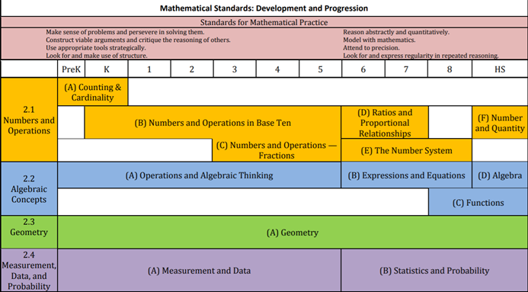
Math Standards
.
Notes:
The PA Core Standards for Mathematics detail four standard areas: Numbers and Operations, Algebraic Concepts, Geometry, and Measurement,
Data, and Probability. These standard areas are reflective of the reporting categories in the PA Core Assessment Anchors and Eligible Content. The
intent of this document is to provide a useful tool for designing curriculum, instruction, and assessment. The grade level curriculum and instructional
shifts in mathematics cannot occur without the integrated emphasis on content and practice. The chart above illustrates the four standard areas and
the development and progression of the strands, with an understanding that all is framed around the Standards for Mathematical Practice.

Slide 6
PA Core Standard
ELA Naming Conventions
6
CC. 1. 2. 3. A
PA Core
Reading Informational Skills
Standard 1
English Language Arts
Grade Level
Standard Categories:
1 Foundation Skills
2 Reading Informational Skills
3 Reading Literature
4 Writing
5 Speaking and Listening
6
Notes:
The numbering structure of the PA Core ELA Standards.

Slide 7
PA Core Standard
Math Naming Conventions
7
CC. 2. 2. 4. A
PA Core
Operations and Algebraic Thinking
Mathematics
Grade Level
Standard Categories:
1. Numbers and Operations
2. Algebraic Concepts
3. Geometry
4. Measurement, Data, and Probability
7
Notes:
The numbering structure of the PA Core Math Standards.

Slide 8
Downloading Standards
Download the standards for your content area.
Scan through the document and focus on your grade level/course.
  How are the standards organized?
  What questions might you have about the standards?

Slide 9
Vertical Progression of a Standard
The SAS Vertical Viewer offers a grade-by-grade progression of how the standards “grow.”
Access the SAS Vertical Viewer and select a standard in your grade level.
  What changes from grade to grade as you follow the standard through the grades?
  How does the standard grow in complexity?

Slide 10
Emphasis Guides
Emphasis Guides detail the major concepts/topics for a grade level.

Slide 11
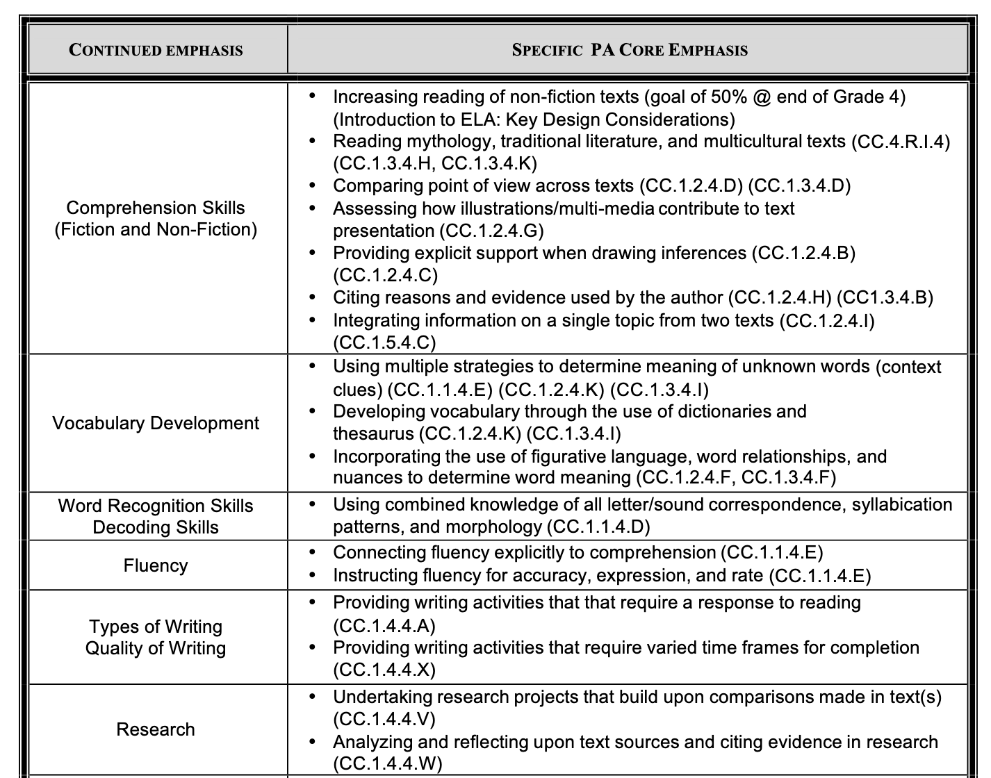
Emphasis Guide - Grade 4
ELA
11
Notes:
Note the Grade 4 ELA example.

Slide 12
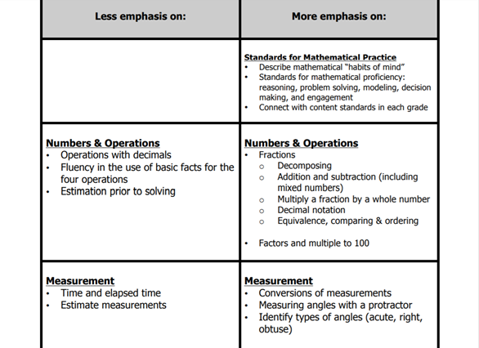
Emphasis Guide - Grade 4
Math
12
12
Notes:
Note the Grade 4 math example.

Slide 13
Emphasis Guides
Doownload the Emphasis Guide for your grade level.
Scan the areas of emphasis and consider they relate to the Long Term Transfer Goals, Big Ideas, and Essential Questions.
How well does your curriculum align with the areas of emphasis?
Notes:
Browse through the emphasis guide for your subject area and grade/course. What are the key concepts? How do they relate to the Long Term Transfer Goals, Big Ideas, and Essential Questions?

Slide 14
Anchor and Eligible Content
Anchor and Eligible Content documents are a blueprint for state assessments.
Notes:
\

Slide 15
ELA Assessment Anchors and Eligible Content
E. 03. B-K. 1. 1. 2
Grade
Eligible
Content
Assessment Anchor
Anchor
Descriptor
Reporting Categories
A = Literature Text
B = Informational Text
A-K and B-K = Key Ideas and Details
A-C and B-C = Craft and Structure/Integration of Knowledge and Ideas
A-V and B-V = Vocabulary Acquisition and Use
C = Writing
D = Language
15
Notes:
The numbering structure of the PA Assessment Anchors and Eligible Content – ELA. Note the multiple reporting categories.

Slide 16
Math Assessment Anchors and Eligible Content
M. 04. B-O. 2. 1. 1
Grade
Eligible
Content
Assessment Anchor
Anchor
Descriptor
Reporting Categories
A-T = Numbers and Operations in Base Ten
A-F = Numbers and Operations—Fractions
B-O = Operations and Algebraic Thinking
C-G = Geometry
D-M = Measurement and Data
16
Notes:
The numbering structure of the PA Assessment Anchors and Eligible Content – Math. Note the multiple reporting categories.

Slide 17
Downloading AA/EC
Download the AA/EC for your content area: PSSA (3-8) or Keystone Exams.
Read through the introductory pages and note the following:
  What are the reporting categories?
  What is the relationship between Anchor and Eligible Content?

Slide 18
Understanding AA/EC
Select a reporting category and note the relationship among the Anchor, Anchor Descriptor, the Eligible Content, and the related standard.
  What is the purpose of the Eligible Content?
  Where should you focus your instruction?
Notes:
Eligible Content (EC) sets the parameters for testing. While important, focus should be on the standard and how the EC relates to overall understanding of the concept.

Slide 19
Standards and Rigor
How do the standards grow in rigor as grade levels increase?
Notes:
\

Slide 20
Let’s Review Depth of Knowledge (DOK)
Like assessments, standards also reflect a DOK.
A scale of cognitive demand (thinking) to align standards with assessments
Based on the research of Norman Webb, University of Wisconsin Center for Education Research and the National Institute for Science Education
Defines the “ceiling” or highest DOK level for each Core Content standard for the state assessment
Guides item development for state assessments
Notes:
What is Depth of Knowledge (DOK)?

Slide 21
Levels of
Cognitive Complexity
Level 1: Recall and Reproduction
Level 2: Skills & Concepts
Level 3: Strategic Thinking
Level 4: Extended Thinking

Slide 22
Webb’s DOK
DEFINITIONS
1.0 | Student recalls facts, information, procedures, or definitions.
2.0 | Student uses information, conceptual knowledge, and procedures.
3.0 | Student uses reasoning and develops a plan or sequence of steps; process has some complexity.
4.0 | Student conducts an investigation, needs time to think and process multiple conditions of problem or task.
22

Slide 23
Depth of Knowledge
The Depth of Knowledge is NOT determined by the verb, but the context in which the verb is used and the depth of thinking required.
Notes:
Depth of Knowledge
The Depth of Knowledge is NOT determined by the verb, but the context in which the verb is used and the depth of thinking required.
This slide points out the danger of the oversimplification by only using the verb to determine DOK. The next slide will illustrate this point further.

Slide 24
One Verb...three DOK levels
The verb is not the indicator of DOK.
DOK 3- Describe a model that you might use to represent the relationships that exist within the rock cycle. (requires deep understanding of rock cycle and a determination of how best to represent it)
DOK 2- Describe the difference between metamorphic and igneous rocks. (requires cognitive processing to determine the differences in the two rock types)
DOK 1- Describe three characteristics of metamorphic rocks. (simple recall)
Notes:
One verb, three different DOK levels (Handout-Hess Matrix)
DOK 3- Describe a model that you might use to represent the relationships that exist within the rock cycle. (requires deep understanding of rock cycle and a determination of how best to represent it)
DOK 2- Describe the difference between metamorphic and igneous rocks. (requires cognitive processing to determine the differences in the two rock types)
DOK 1- Describe three characteristics of metamorphic rocks. (simple recall)
Distribute the Hess Matrix handout.
The Hess matrix gives you a more precise way of determining DOK. On the left you will see Bloom’s Taxonomy. Think of a task that you would have student do and decide where it would fit in Bloom’s Taxonomy. Now move to the right across the matrix to determine DOK.

Slide 25
Remember…
Using PA Core to identify the DOK of a Standard Math (Geometry)
Grade 3 | Grade 7 | High School
CC.2.3.1.A.2 Use the understanding of fractions to partition shapes into halves and quarters. | CC.2.3.7.A.2 Visualize and represent geometric figures and describe the relationships between them. | CC.2.3.HS.A.2 Apply rigid transformations to determine and explain congruence.
Notes:
Consider DOK:
Grade 3 – Level 2 – Students use conceptual knowledge.
Grade 7 – Level 3 – Students use reasoning to make the relationship between properties; process has some complexity.
Grade 11-12 – Level 3 – Students must apply complex thinking utilizing multiple operations to solve a problem.

Slide 26
Remember…
Identify the DOK of a Standard
ELA (Text Analysis)
Grade 3 | Grade 7 | High School
CC.1.2.3.B Ask and answer questions about the text and make inferences from text; refer to text to support responses. | CC.1.2.7.B Cite several pieces of textual evidence to support analysis of what the text says explicitly, as well as inferences, conclusions, and/or generalizations drawn from the text. | CC.1.2.11–12.B Cite strong and thorough textual evidence to support analysis of what the text says explicitly, as well as inferences and conclusions based on and related to an author’s implicit and explicit assumptions and beliefs.
Notes:
Consider DOK:
Grade 3 – Level 2 – While asking and answering questions may be a low DOK, using information to make inferences is a higher level.
Grade 7 – Level 2 – Again, using the text to support analysis is a DOK 2.
Grade 11-12 – Level 3 – This standard requires more complex thinking.

Slide 27
For Reflection…
How do standards guide my teaching?

